Slide 1
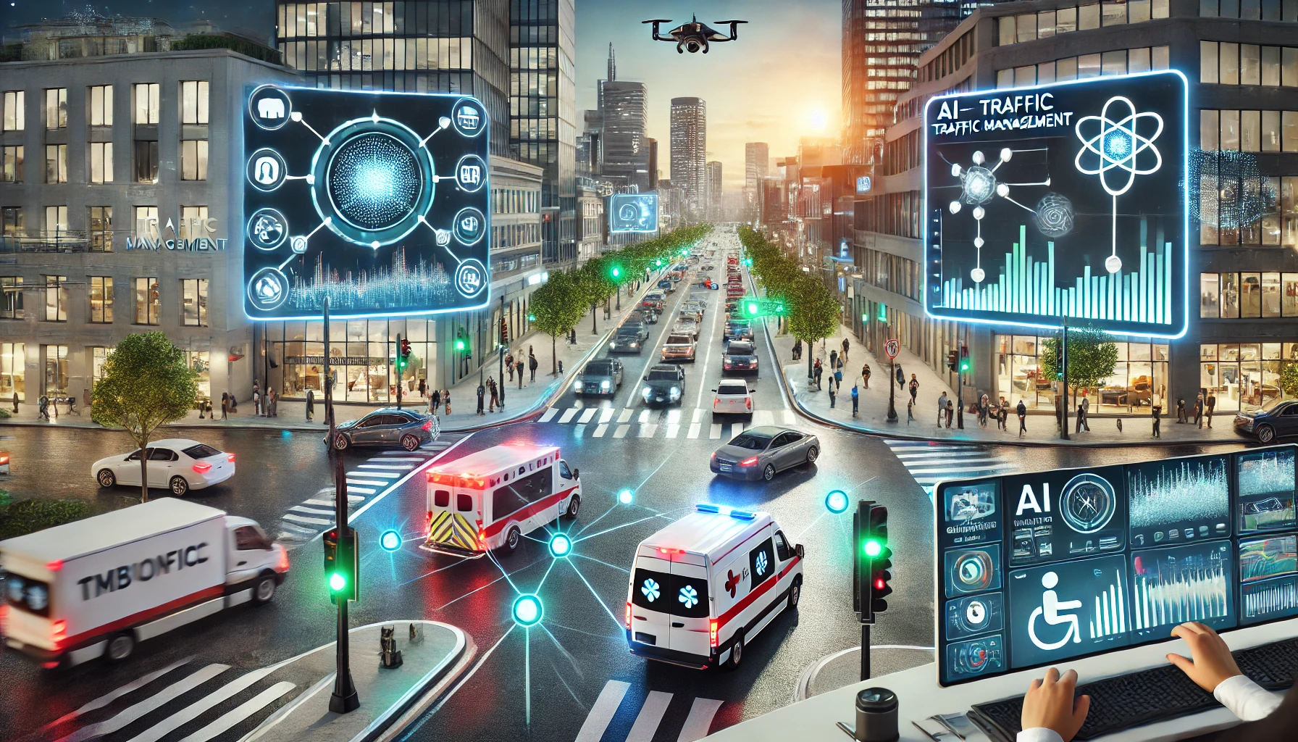
Smart Traffic Management System :
Optimization and Analysis using YOLOv8
Authors:
Aryan Ghadekar
Keshav Tambre (Guide)
Arjun Gaware
Yash Gawande
Aditya Ghadge
Kirti Genge
Omkar Ghantalwad

Slide 2
INTRODUCTION
The main aim of the proposed system is to develop a Smart Traffic Management System that uses YOLO based object detection to monitor and manage real-time traffic through CCTVs.
The key features of the system include dynamic traffic signal control based on vehicle density and ambulance priority.
The system is designed to improve traffic efficiency, ensure faster emergency response, and enhance overall road safety.

Slide 3
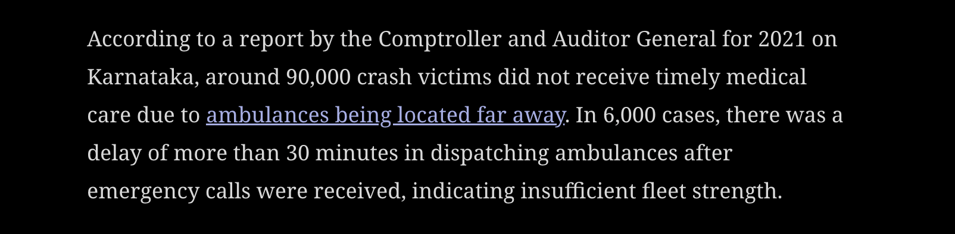
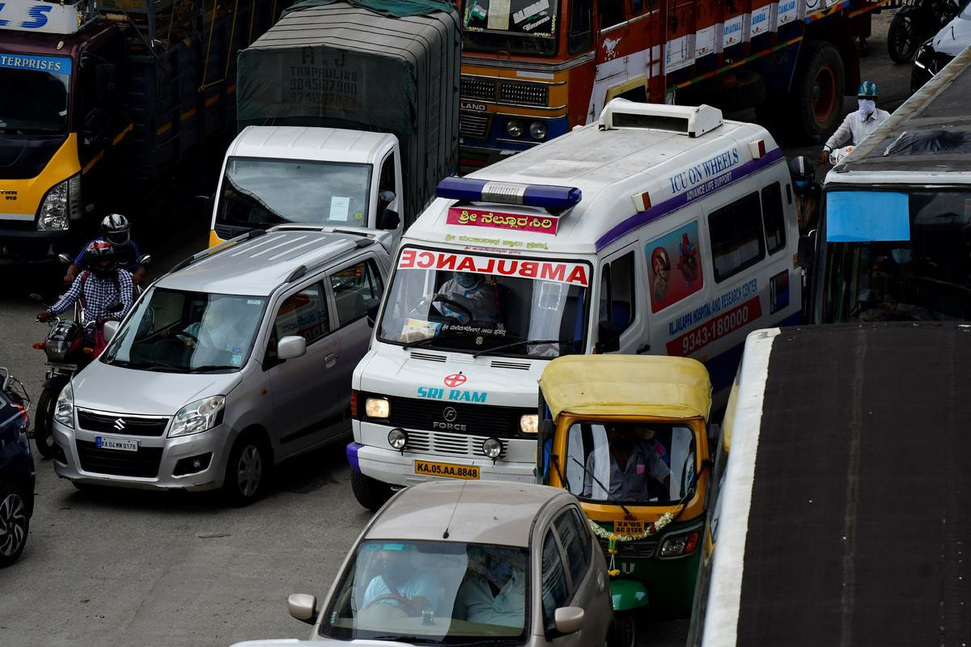
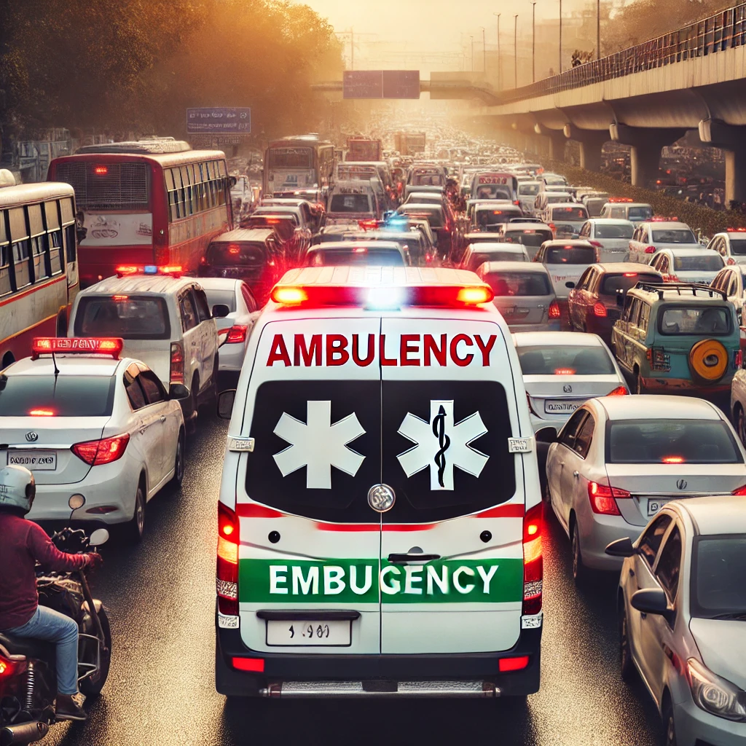
TRAFFIC DELAYS: A SILENT KILLER IN THE EMERGENCY CARE
Thousands of patients in India die daily due to traffic delays. As per the recent article of the Ministry of Road Transport and Highways, around 21,042 deaths occur each day due to traffic-related delays.

Slide 4
MOTIVATION
Fixed-time signals waste time, fuel, and energy, increasing pollution.
Emergency vehicles get delayed in traffic, affecting response times.
It reduces idle time, fuel consumption, and emissions while improving traffic flow and emergency response.
Innovation:
Our ML-based system dynamically controls signals using real-time traffic data.
Our proposed system has the feature to enable or disable the ambulance priority
Dynamic Signal Switching based on Traffic Density

Slide 5
CHALLENGES FACED
Dataset Creation (No dataset available for Ambulance in India)
Labelling Dataset (over 40,000 Images )
Dataset Imbalance
Dataset Augmentation
Hyperparameter Tuning
Hardware Constraints for training the dataset (GPUs)

Slide 6
TOOLS USED:
Python: Programming language.
PyTorch (torch): Used for neural network operations and GPU acceleration.
Darknet: A custom neural network framework for YOLO object detection.
OpenCV (cv2): Used for image processing and reading image files.
YOLO (You Only Look Once): Object detection algorithm for vehicle recognition.
Collections (Counter): For counting vehicle types.
Pandas (pd): For data manipulation.
Non-Maximum Suppression (NMS): A technique to reduce overlapping object detections.

Slide 7
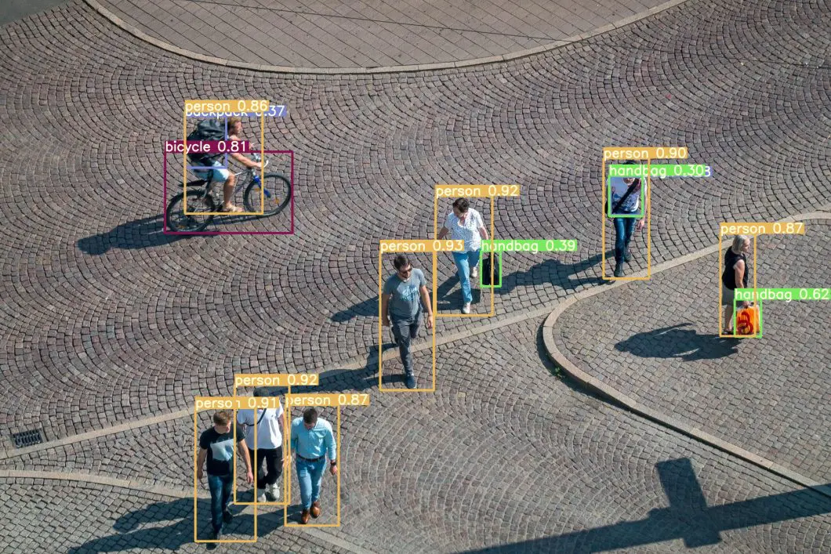
YOLOv8
Unlike v5 and v6, YOLOv8 has higher accuracy and faster speed.
It is easy to use and develop.
The model identifies objects and locates object in an image by placing bounding boxes around them.

Slide 8
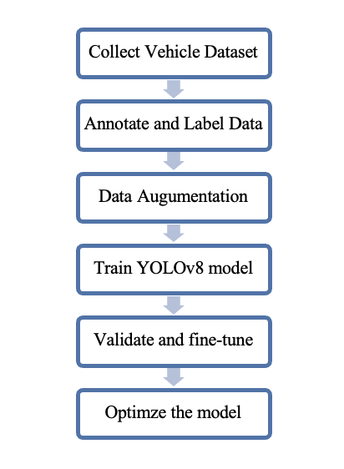
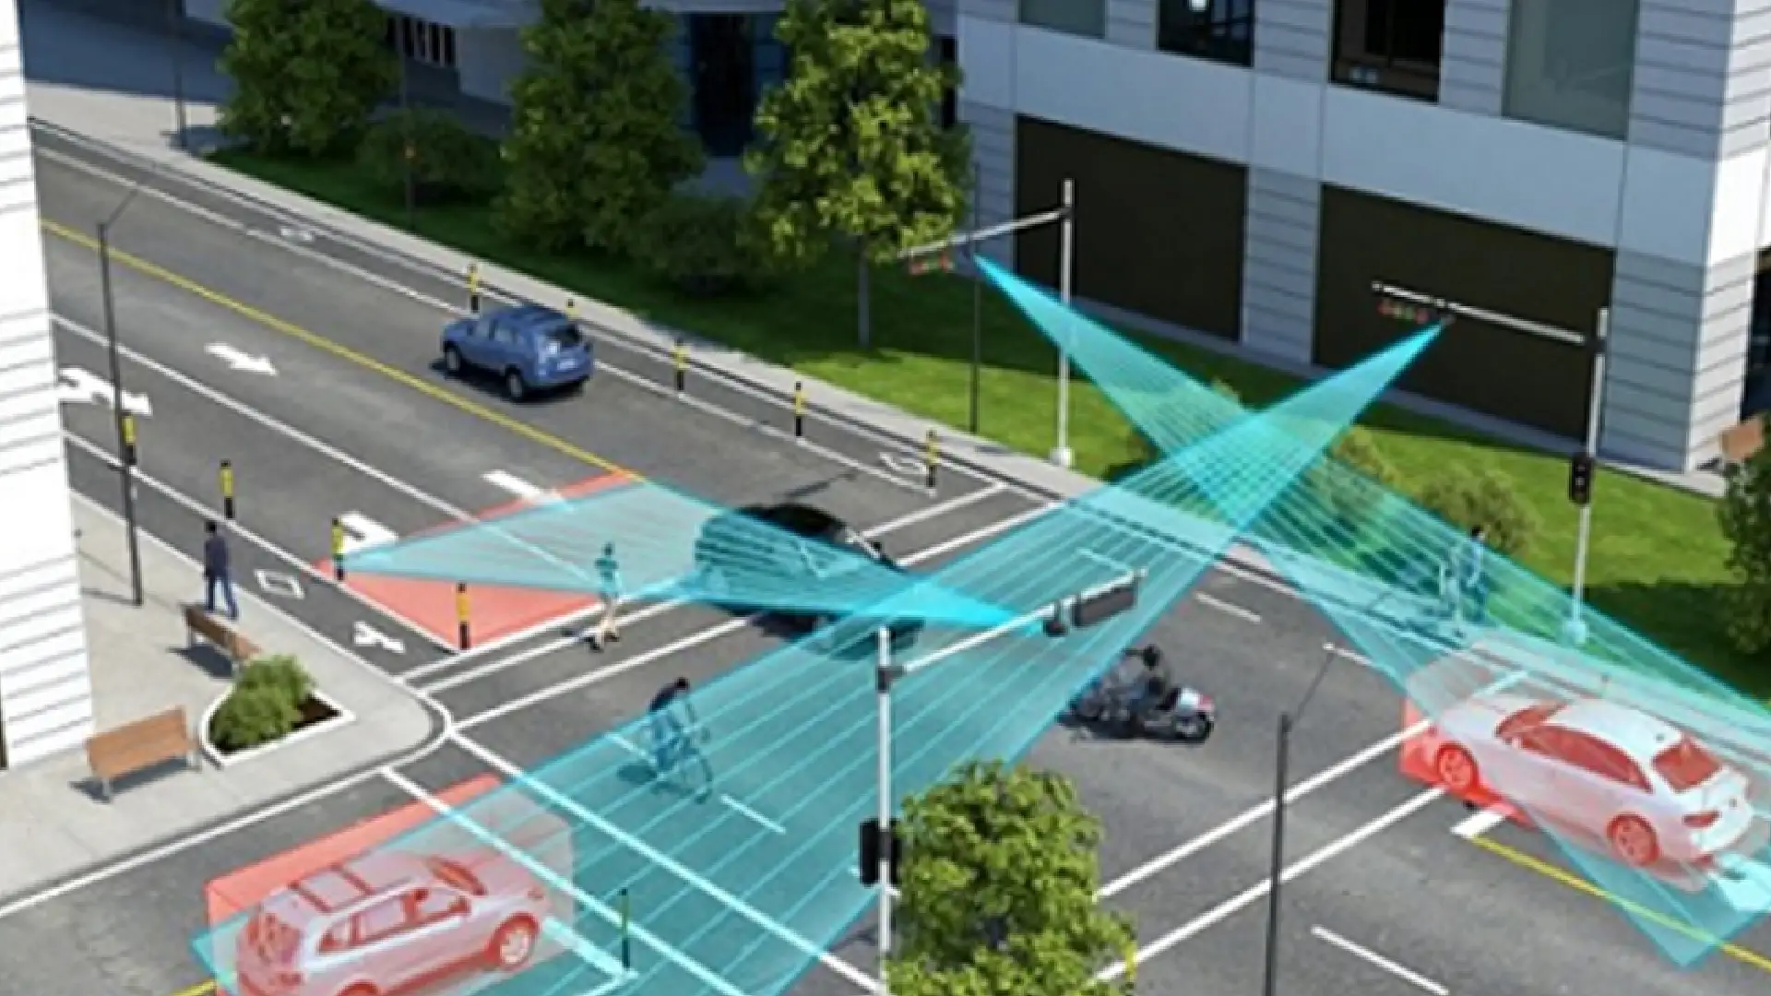
METHODOLOGY - FLOWCHART

Slide 9
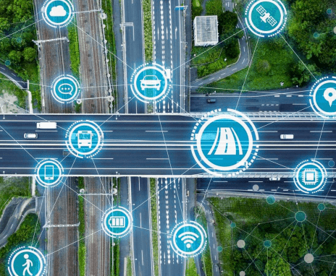
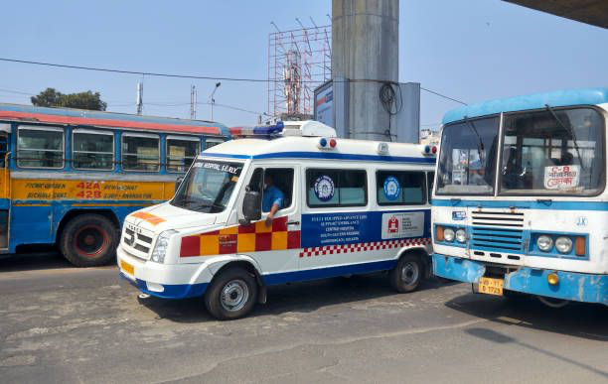
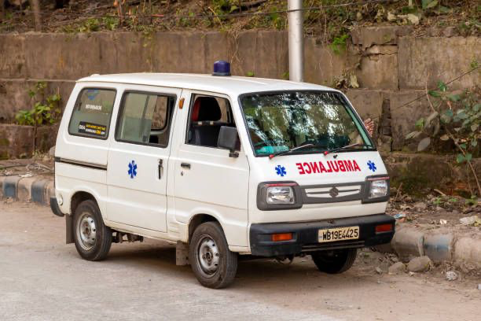
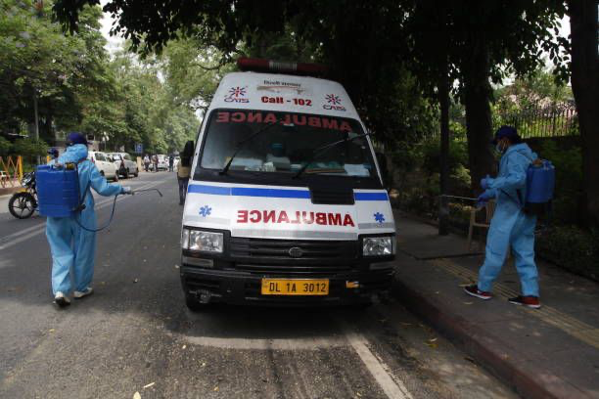
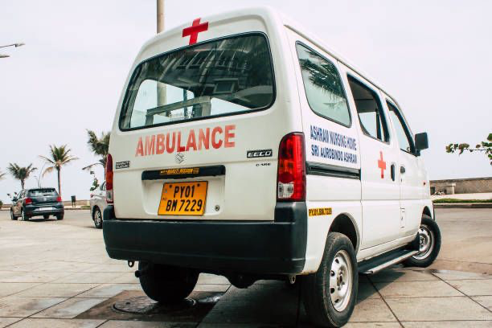
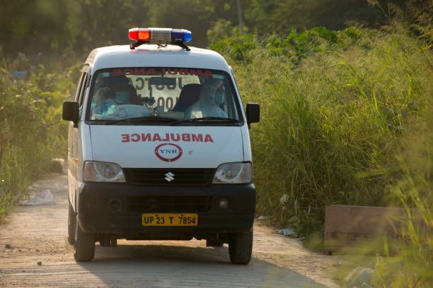
METHODOLOGY
Dataset Collection: High-resolution images of various vehicles, annotated and split into training (70%), validation (20%), and testing (10%) sets.
Data Augmentation: Flipping, rotation, zoom, shearing, grayscale conversion, color adjustments, blur, and noise addition for robustness.

Slide 10
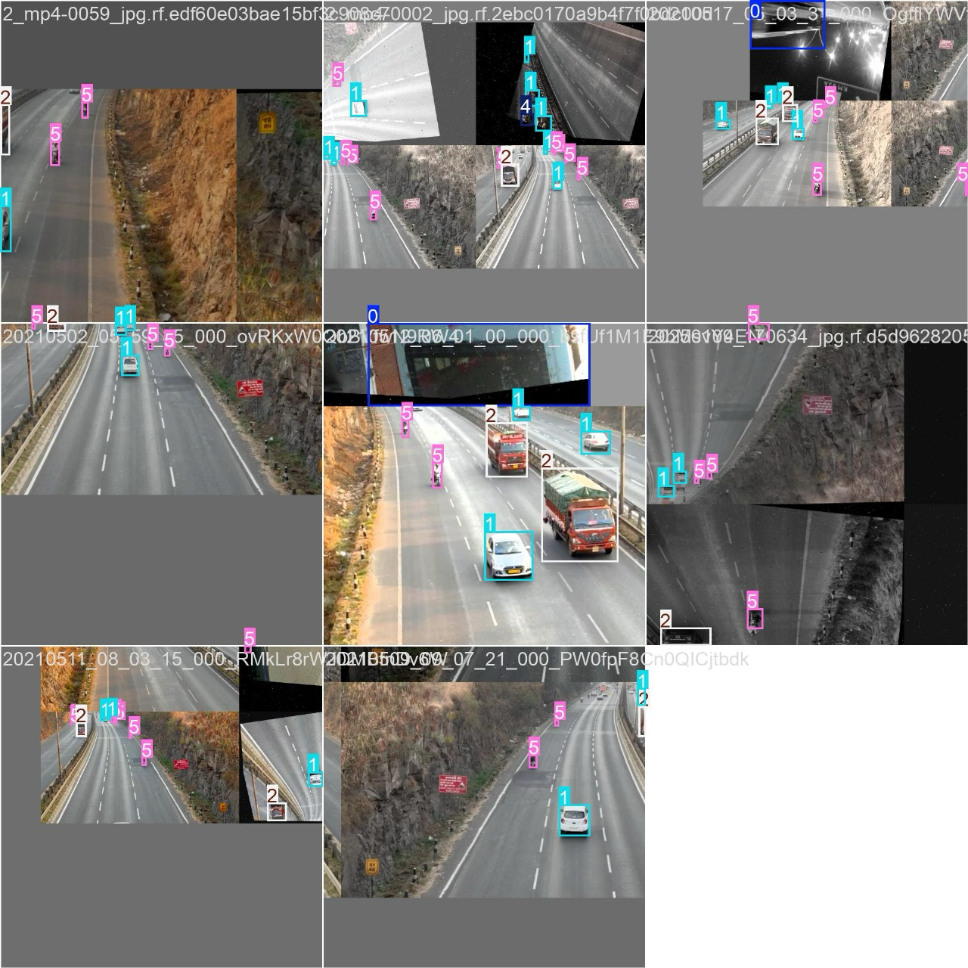
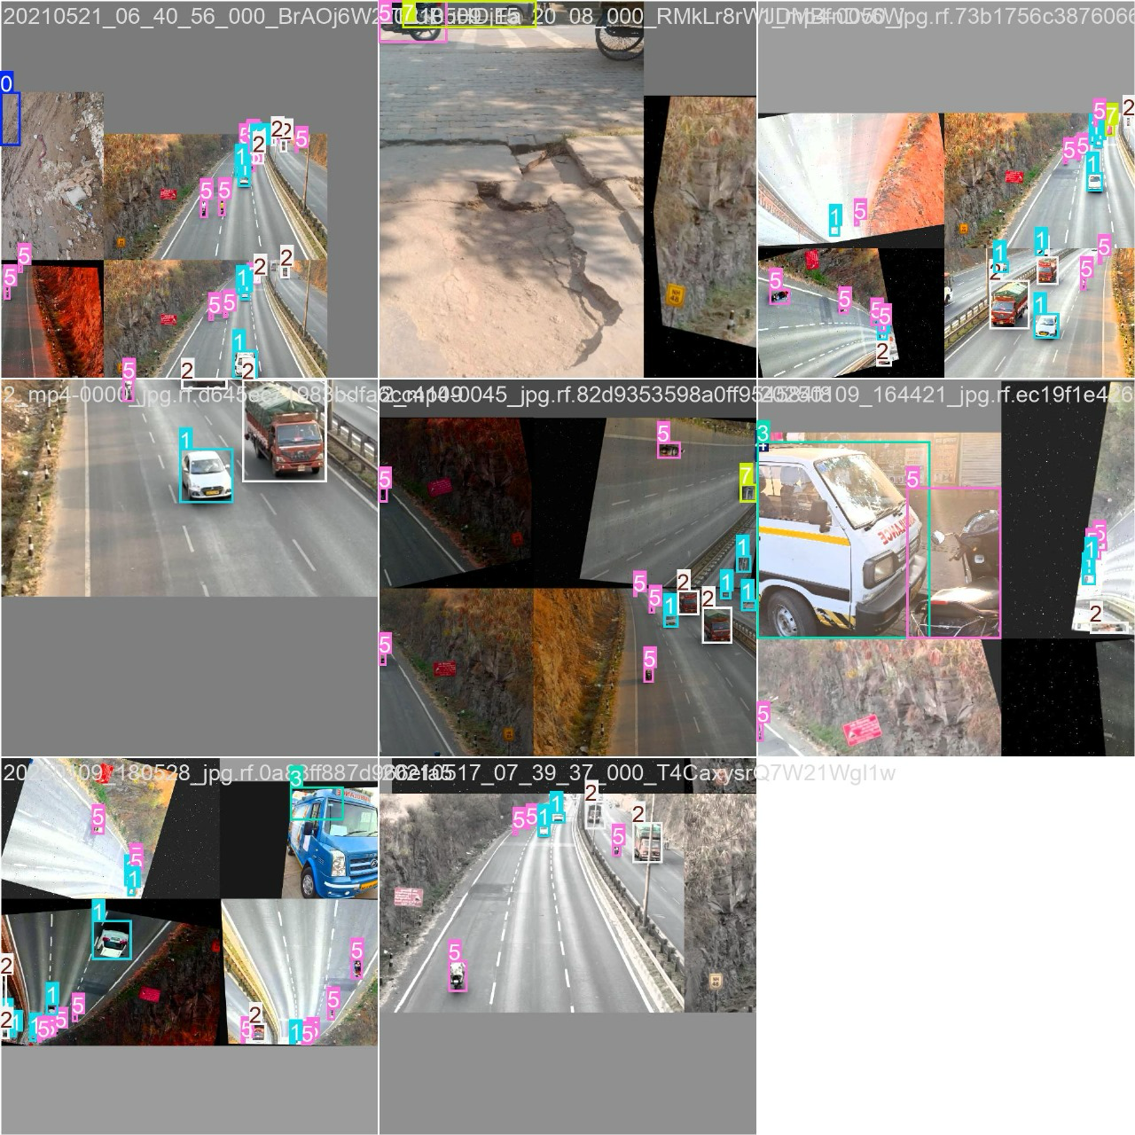
METHODOLOGY
Model Training: YOLOv8 fine-tuned on a custom dataset using optimized hyperparameters. Training conducted on an Nvidia Tesla V100 GPU.
Testing & Validation:
Detection: Vehicles and ambulances identified in traffic images.
Lane Analysis: Vehicle count, ambulance presence, and traffic distribution.
Priority Determination: Ambulances get top priority; otherwise, lanes with highest vehicle density.

Slide 11
METHODOLOGY
Deployment:
Dynamic Signal Control: Adjusts traffic signals based on real-time vehicle density and ambulance presence.
Performance Evaluation: Measures accuracy.

Slide 12
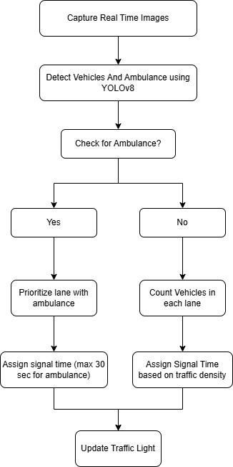
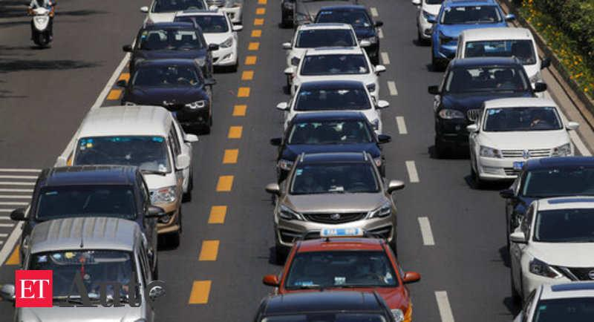
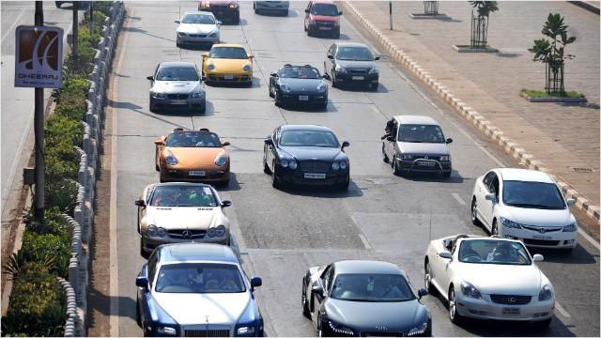
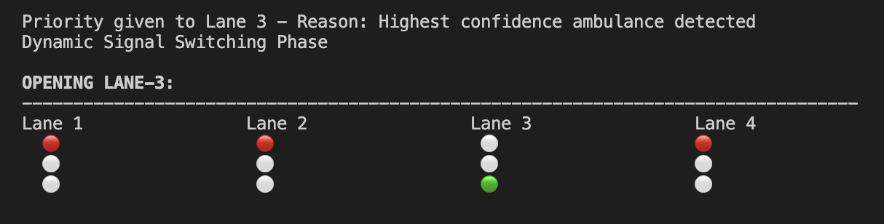
ALGORITHM
Preparing input images by creating dataset
Running object detection with confidence thresholds
Applying non-maximum suppression to refine detection results
Counting and classifying detected vehicles

Slide 13
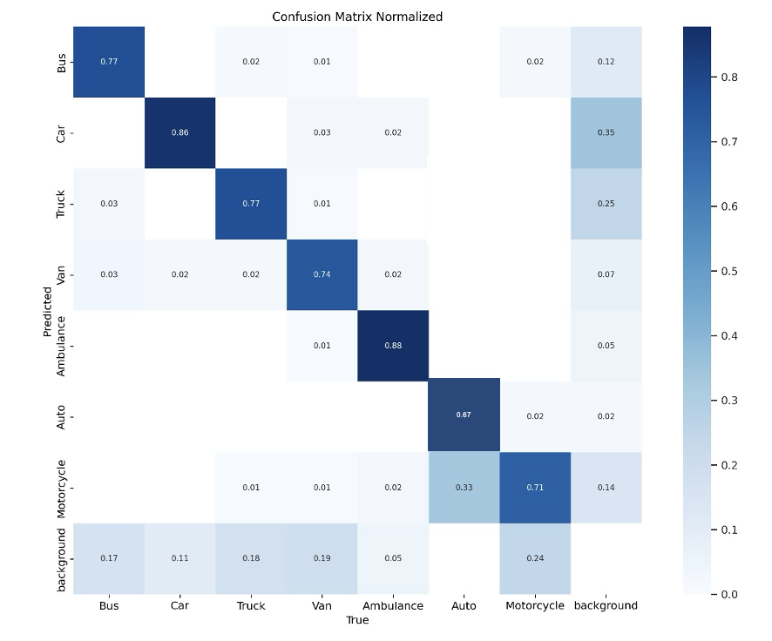
RESULTS AND DISCUSSIONS
Confusion Matrix
It shows that the model accurately detects various classes of vehicles with an accuracy of 94%

Slide 14
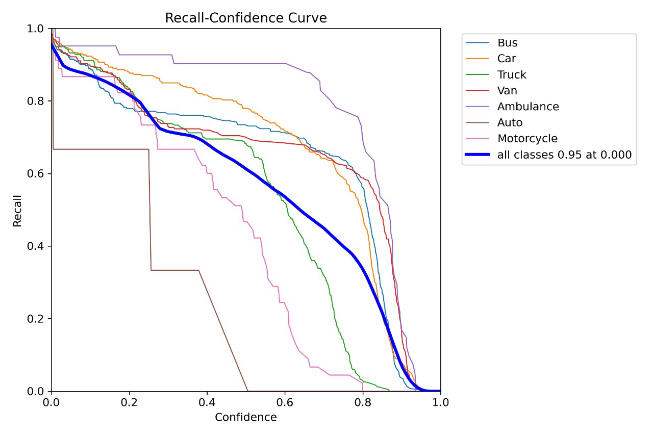
RESULTS AND DISCUSSIONS
Recall Confidence Curve
It depicts that the model can recall across varying confidence thresholds for different object classes.

Slide 15
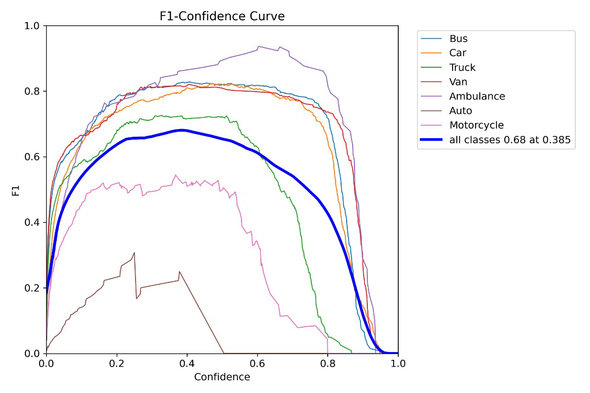
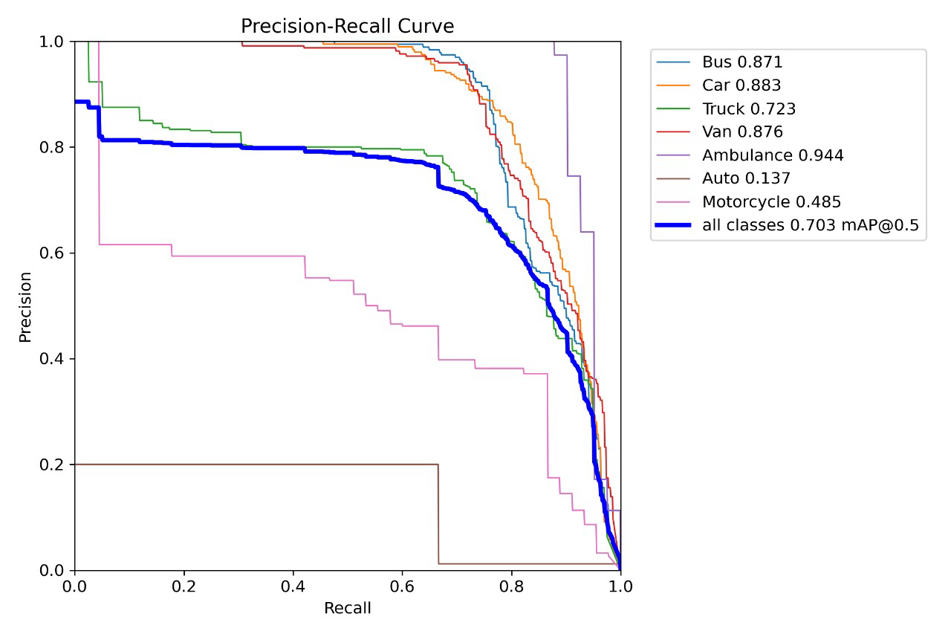
RESULTS AND DISCUSSIONS
F1-Confidence Curve
It illustrates the model's F1-score variation across confidence thresholds for different object classes.
Precision Recall Curve
It highlights class-wise precision and recall trade-offs.

Slide 16

CONCLUSION
Successfully implemented innovative model using YOLOv8 algorithm to detect
Different types of vehicles,
Vehicle detection across multiple lanes (4),
Count vehicles in each lane and
Identify the lane with the densest traffic.
Check for ambulance and if detected prioritize it.
Else give priority to the lane with densest traffic.

Slide 17
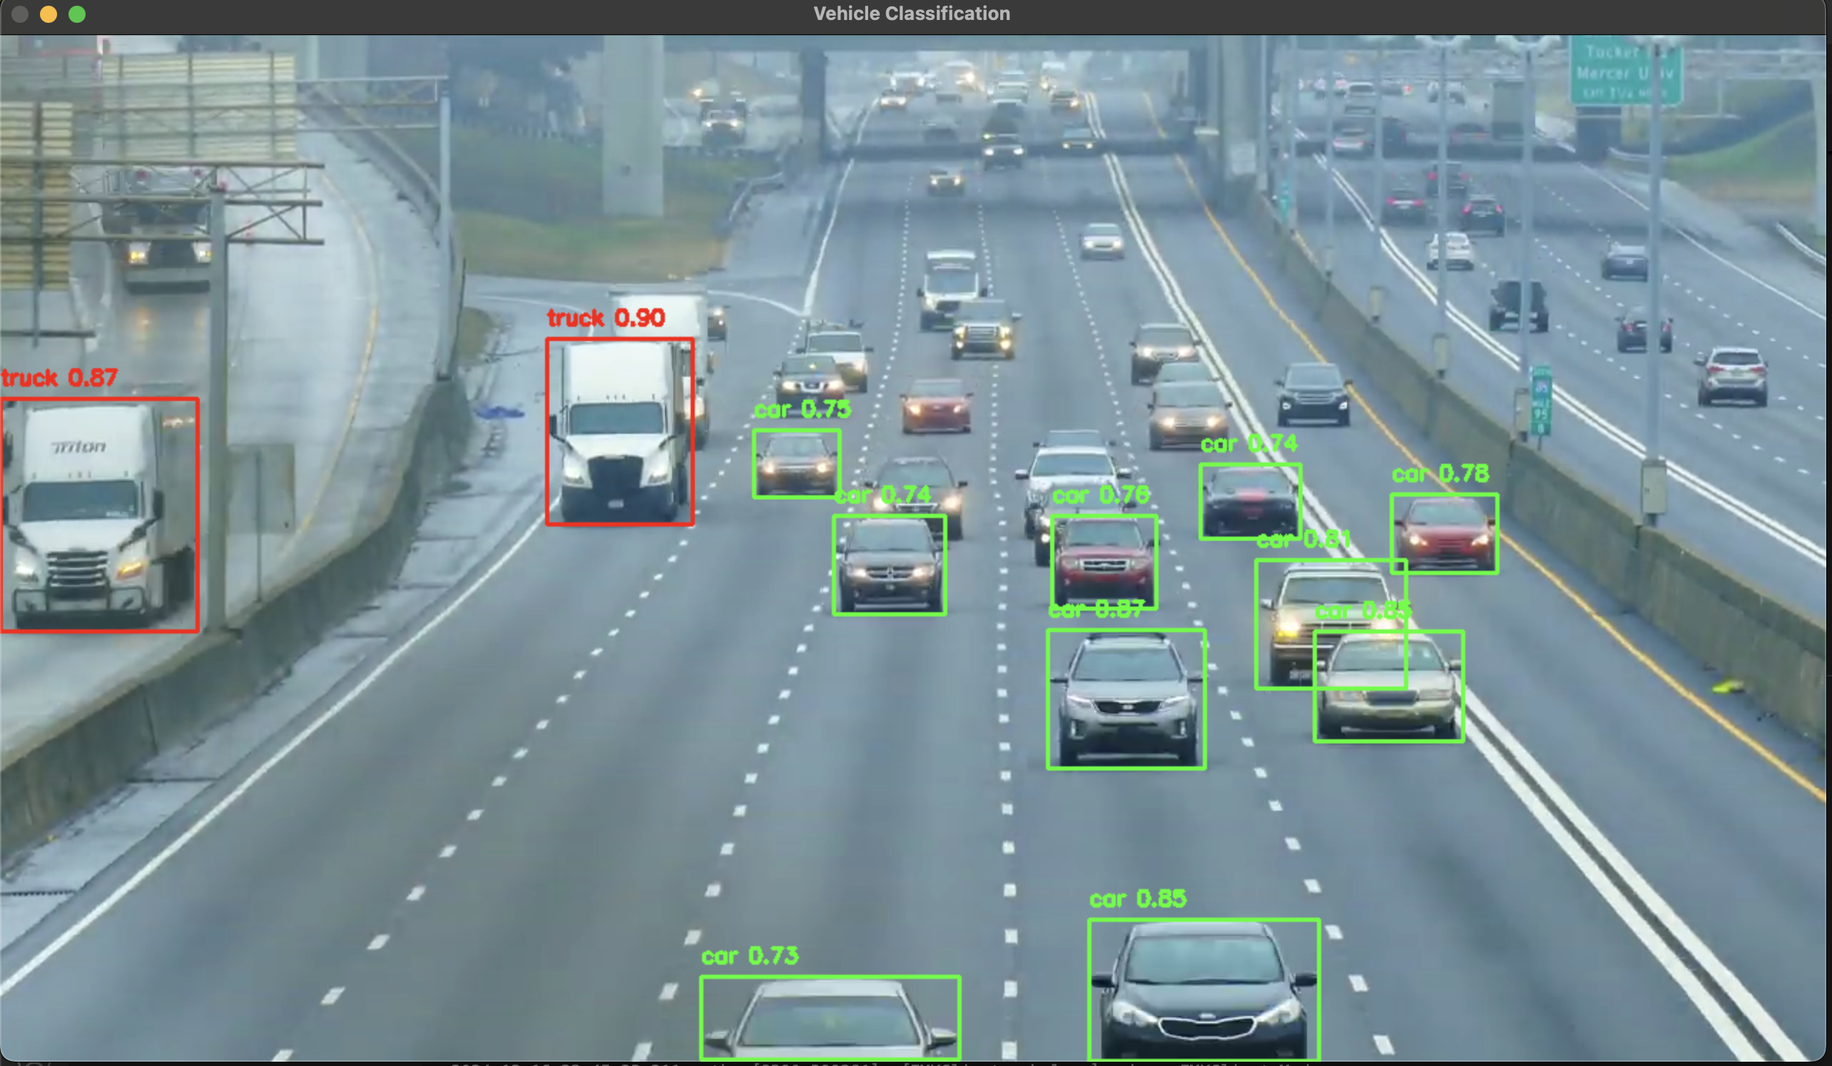
OUTPUT

Slide 18
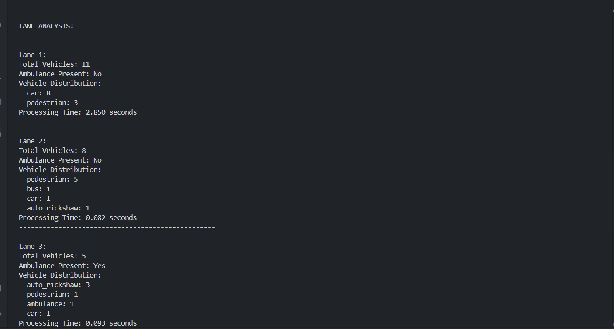
FINAL-OUTPUT

Slide 19
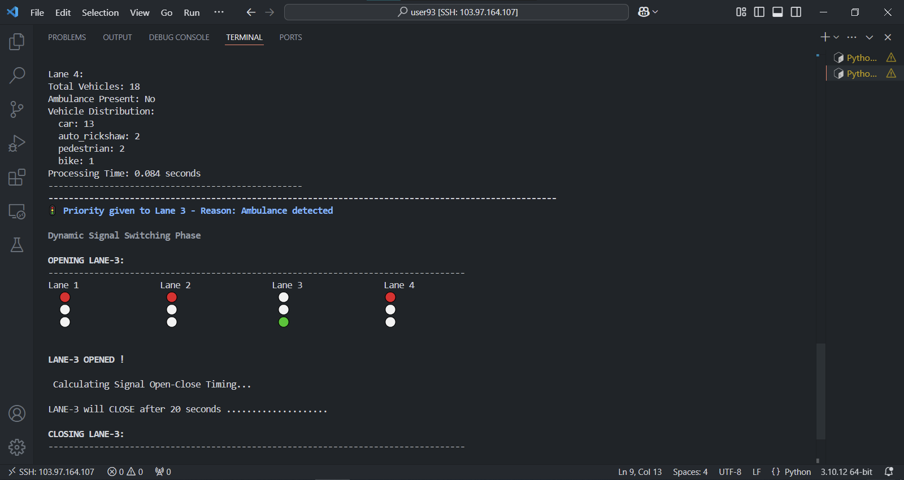
FINAL-OUTPUT

Slide 20

Thank You!

